Slide 1
Bio& 242 A&P
Unit 4 / Lecture 3

Slide 2
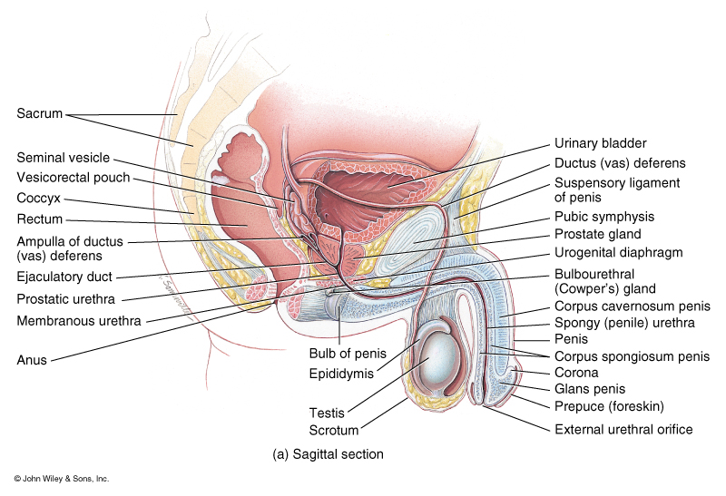
Anatomy of the Male
Reproductive System

Slide 3
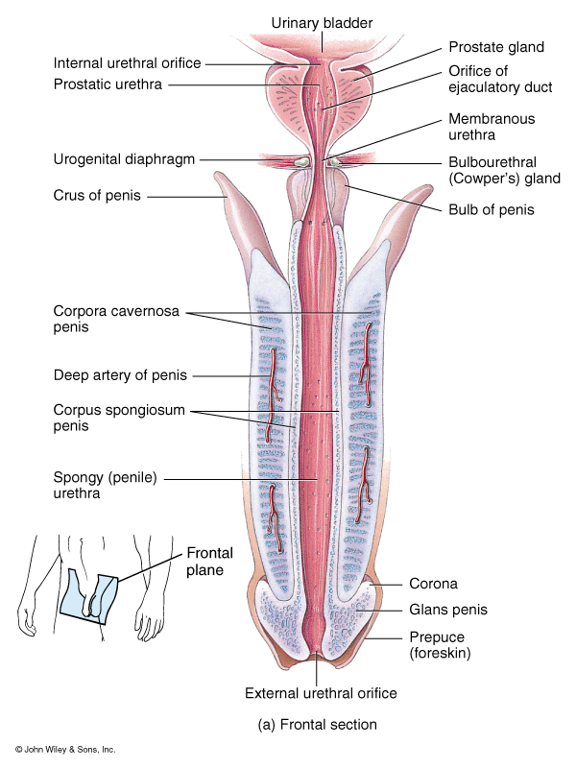
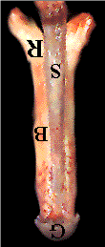
Penis: Average flaccid length 3 -4 inches
Average Erect length 5 - 6
Average length of the vagina 3 -6 inches

Slide 4
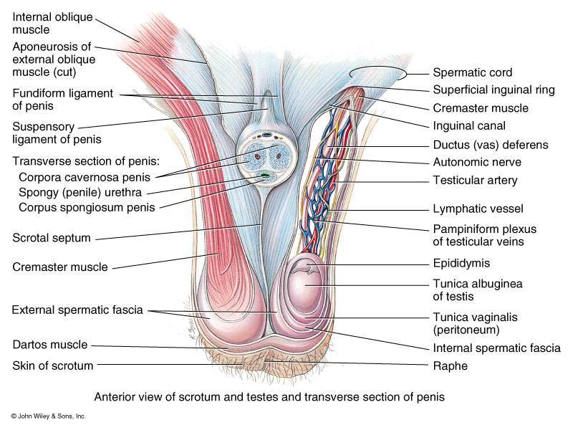
Anatomy of the Male
Reproductive System

Slide 5
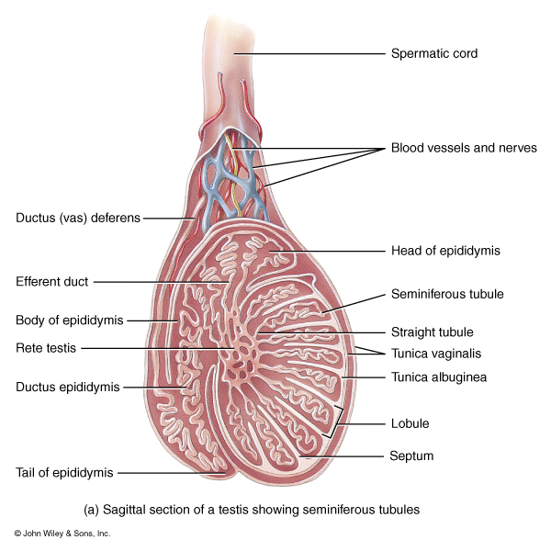
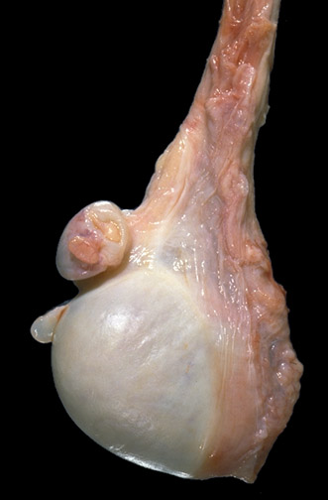
Internal and external anatomy of the Testis
Pathway for Sperm
1. Seminiferous tubule
2. Straight tubule
3. Rete testis
4. Efferent duct
5. Ductus Epididymis
6. Ductus deferens

Slide 6
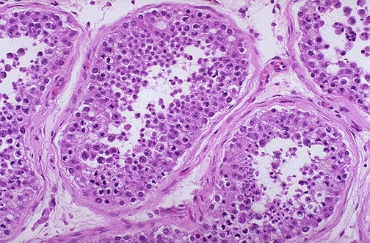
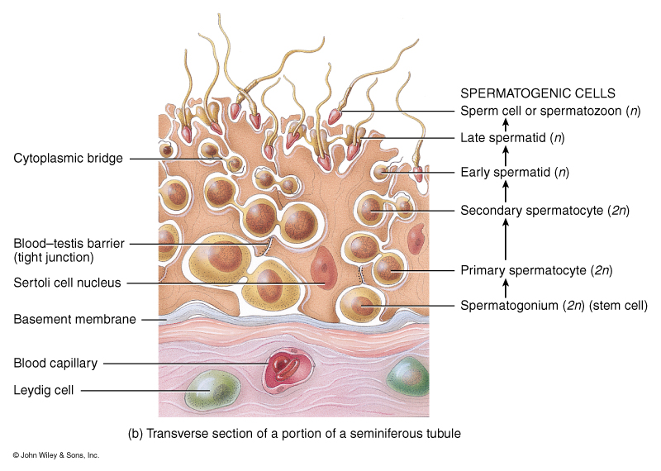
Histology of the Testis and Spermatogenesis

Slide 7
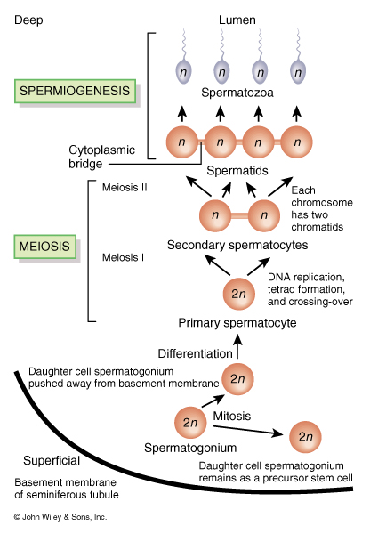
Steps of Spermatogenesis
Spermatogonia: diploid stem cells that undergo mitosis to give rise to daughter cells that either become primary spermatocytes or remain as spermatogonia
Primary spermatocytes: diploid cells that undergo meiosis 1
Secondary spermtocytes: haploid cells formed from meiosis 1

Slide 8
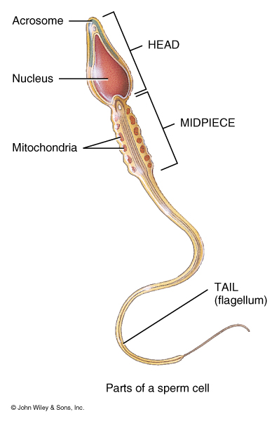
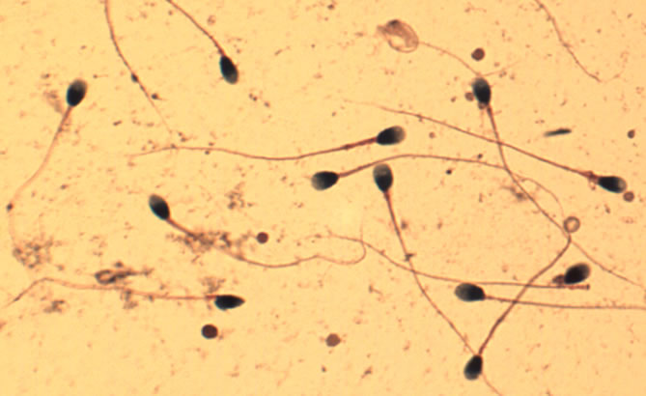
Steps of Spermatogenesis
Spermatids: Cells resulting from meiosis II, become spermatozoa

Slide 9
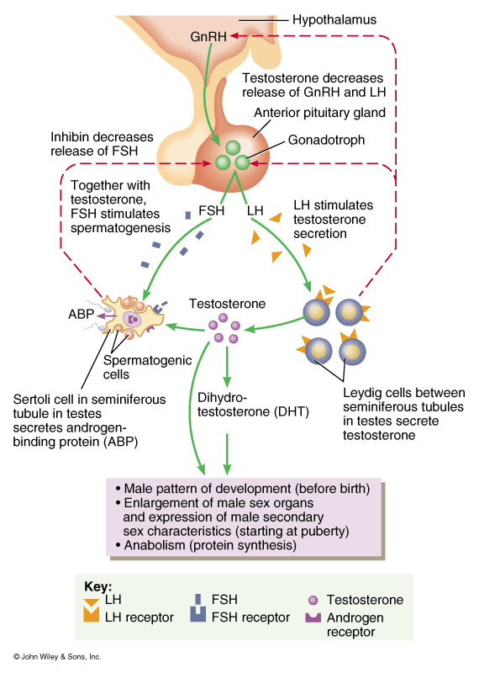
Hormonal control of the
Male Reproductive System
Hypothalamus releases GnRH
GnRH stimulates the Gonadotrophs of the adenohypophysis to release FSH and LH
FSH stimulates Sertoli cells to secrete Androgen-binding protein (ABP) and stimulates spermatogenesis.

Slide 10
Hormonal control of the
Male Reproductive System
LH stimulates the Leydig cells to secrete testosterone
Inhibin secreted by Sertoli cells controls the release of FSH by gonadotrophs

Slide 11
Male Menopause Myth or Reality?
Andropause
At 40 testosterone levels begin to decline
Between 45 and 50 there is a steep drop in blood levels
By 80 50% of men have low testosterone levels
Signs and symptoms
1. Reduced sex drive
2. Infertility
3. Decrease spontaneous erections (during sleep)
4. Swollen/tender breast (gynecomastia)
5. Loss of body and pubic hair
6. Small or shrinking testes
7. Decrease in muscle mass
8. Hot flushes
9. Decrease energy, motivation, and self-confidence
10. Poor concentration and memory
11. sleep apnea
12. Mild anemia

Slide 12
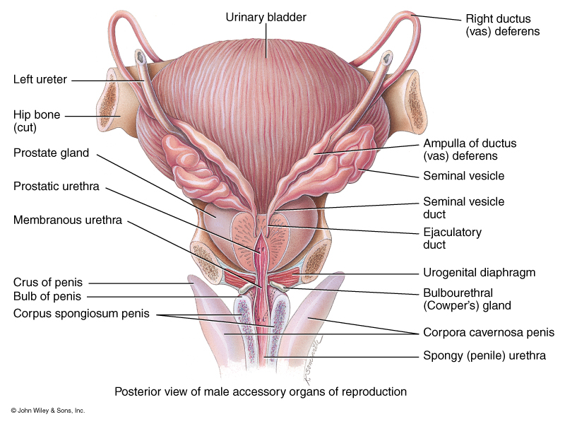
Organs involved in the
Production of Semen
Seminal Fluid: Volume of a typical ejaculation is 2.5 –5.0ml with a sperm count of 50 –150 million sperm (under 20 million sperm is considered infertile), fluid is slightly alkaline at pH 7.2 –7.7.
Seminal Vesicles: Produce 60% of the volume of seminal fluid; SV’s produce an alkaline viscous fluid that contains: fructose, prostaglandins, and clotting proteins

Slide 13
Organs involved in the
Production of Semen
Prostate Gland: Produce 25% of the volume of seminal fluid; This fluid is a milky, slightly acidic fluid that contains citric acid (for ATP production), acid phosphatase along with several other enzymes ( prostate-specific antigen PSA, pepsinogen, and lysozyme
Bulbo-urethral gland: produces alkaline mucus that help lubricate the urethra and the head of the penis
Ampulla of ductus deferens: releases up to 150 million sperm cells

Slide 14
Prostate cancer
Prostate cancer is made up of cells that do not grow normally. The cells divide and create new cells that the body does not need, forming a mass of tissue called a tumor. These abnormal cells sometimes spread to other parts of the body, multiply, and cause death.
How common is prostate cancer?
For the general population, a man in his lifetime has about a
16 % of being diagnosed with prostate cancer.
3 % of dying from prostate cancer.
Who is at increased risk for prostate cancer?
Family history: Men with a father or brother who has had prostate cancer are at greater risk for developing it themselves.
Race: Prostate cancer is more common in African-American men than in white men. It is less common in Hispanic, Asian, Pacific Islander, and Native American men than in white men.

Slide 15
Prostate Cancer Symptoms
Urinary problems
  Not being able to urinate
  Having a hard time starting or stopping the urine flow
  Needing to urinate often, especially at night
  Weak flow of urine
  Urine flow that starts and stops
  Pain or burning during urination
Difficulty
  having erections
  Blood in urine
  Blood in semen
  Frequent pain in the lower back,
  hips, or upper thighs

Slide 16
Prostate Cancer Screening
Second leading cancer deaths among men
DRE or digital (finger) rectal examination:
A quick exam for checking the health of the prostate. For this test, the doctor inserts a gloved and lubricated finger into the rectum. This allows the doctor to feel the back portion of the prostate for size and any irregular or abnormally firm areas.
PSA "prostate-specific antigen."
PSA is a substance produced by cells from the prostate gland and released into the blood. The PSA test measures the PSA level in the blood. A small amount of blood is drawn from the arm. The doctor checks the blood to see if the PSA level is normal. The doctor may also use this test to check for any increase in your PSA level compared to your last PSA test.

Slide 17
Prostate Cancer Staging
Stage I: The cancer cannot be felt during a digital rectal exam. The cancer is only in the prostate.
Stage II: The cancer is more advanced, but it has not spread outside the prostate.
Stage III: The cancer has spread outside the prostate to near by tissues, but not lymph nodes.
Stage IV: The cancer may be in nearby muscles and organs (beyond the seminal vesicles). It may have spread to the lymph nodes

Slide 18
The Male Sexual Response
Arousal: various erotic thoughts and physical stimulation triggers parasympathetic reflexes that cause an erection.
Erection: occurs when neurons release Nitric oxide at their synaptic endings.
NO causes smooth muscles of the penile arteries to relax, vessels dilate, blood flow to the erectile tissue increases . The vascular channels engorge with blood, resulting pressure causes the penis to become stiff.

Slide 19
The Male Sexual Response
During arousal increases in heart rate, blood pressure, skeletal muscle tone, and hyperventilation occur
Bulbourethral glands: continued stimulation causes the release of mucus from these glands, this mucus lubricates the penile urethra and the glans penis. These secretions can carry sperm.

Slide 20
The Male Sexual Response
Plateau stage: Changes that begin during arousal are sustained at an intense level, head of the penis increases in diameter and the testes swell due to vasocongestion.
Toward the end of the plateau stage, emission occurs.
Emission: sympathetic stimulation causes peristaltic contractions of the ampulla that push fluid and spermatozoa into the ejaculatory duct, peristaltic contractions of the seminal vesicles and the prostate push seminal fluid in the ejaculatory duct and the penile urethra.
Contraction of the internal urethral sphincter and the bladder occurs.

Slide 21
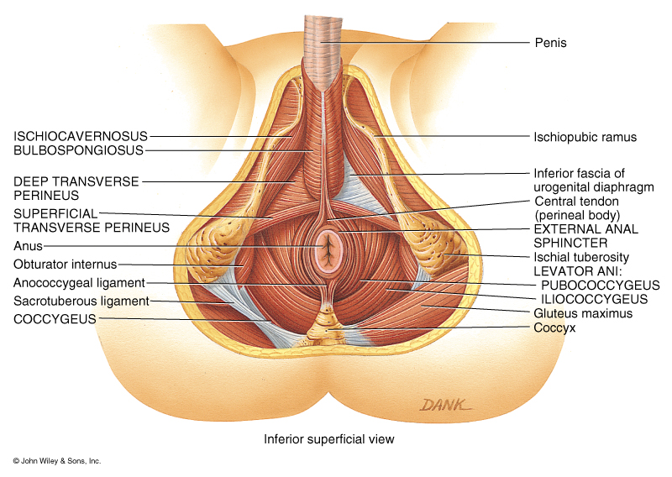
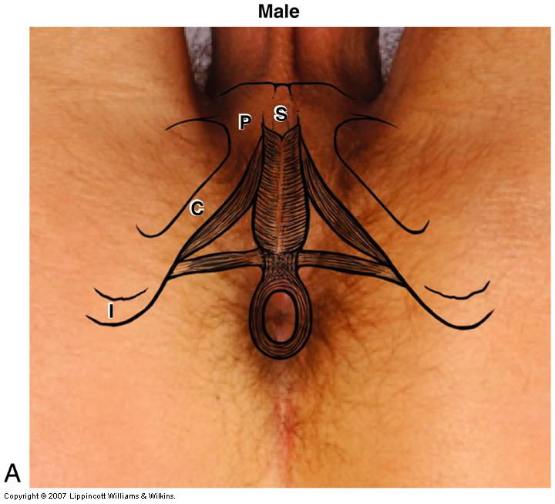
The Male Sexual Response
Ejaculation: Sympathetic stimulation of the ischiocavernosus and bulbospongiosus muscles causes powerful rhythmic contractions that push the semen out of the penile urethra. Also the External anal sphincter contracts
Orgasm; intensely pleasurable sensations associated with ejaculation. Other physiological changes include pronounced increase in heart rate and blood pressure.

Slide 22
The Male Sexual Response
Resolution: Sense of profound relaxation- genital tissues, heart rate, blood pressure, breathing, and muscle tone return to normal.
During early period of resolution, males enter a refractory period during which a second ejaculation and orgasm are physiologically impossible.

Slide 23
